Slide 1



STEAM GAME RECOMMENDERS FROM SCALED AND ORIGINAL DATA
Michael Treacy & Nathan Lamberson
Notes:
Mike
Title is …
Researchers are…

Slide 2


LITERATURE RECAP
Filtering techniques include:
Demographic
Content-based
Collaborative
Hybrid [3]
Best for us? Collaborative filtering [4]
Notes:
Mike
As stated by researchers Mohamed, Khafagy, and Ibrahim, the development of a recommendation system depends on the use of popular techniques such as demographic, content-based, collaborative, and hybrid filtering [3]. Demographic data consists of general information about the user such as gender or location, while content-based filtering focuses more on aspects of the actual products being bought. On the other hand, the collaborative method involves things like making use of the purchase history of all customers and applying association rule mining in order to detect commonalities that will be helpful in predicting people’s preferences [1]. Lastly, a hybrid approach mixes these filtering techniques. Looking at each of these focuses, it was clear that the collaborative method of taking into consideration user behavior would be the most useful to us [4].

Slide 3


THE PLAN
Steam data set
Only purchase and play history included
Collaborative filtering often dependent on sentiment
Primary Goals?
Calculate ratings [5]
Create item-based recommendation system with ratings [6]
Implement 2 user-based models. Model 1 would work with the ratings [7]. Model 2 with the original hours played [8]
Notes:
Mike
That is why the main focus of our student project was to apply collaborative filtering to the collection of Steam user-and-product data we found. The Valve Corporation already has a recommendation system in place. Data ranging from a gamer’s wish-listed items to his or her reviews is collected by the company to guess what type of games the individual may want. Due to our data set only containing purchase and play history and collaborative approaches often depending on the consumer’s item sentiments, we would need to calculate ratings from the hours played in order to have some type of player preference. Helpful guides in scaling and filtering would be utilized. More specifically, min-max normalization would be implemented to reformat the hours into a player rating [5]. This would then be followed by filtering for item-based recommendations [6]. Finally, the user-based recommendation systems would be explored and developed. Each researcher created their own model for the user-based systems in order to provide a means of comparing and learning small deviations in collaborative filtering techniques. Model 1, researched and coded by Michael Treacy, is reported first [7]. Next, model 2, investigated and programmed by Nathan Lamberson, is covered [8]. The ultimate hope was to create novel solutions to Valve’s problem of finding the right games for the right consumers.

Slide 4

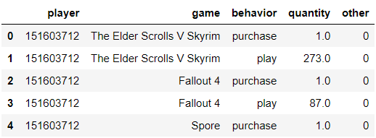

THE DATA SET
Set found on Kaggle [9]
4 informative columns
Utilize libraries such as numpy and pandas [10]
Notes:
Mike
The data set under question can be found on Kaggle, which is a site tailored for the machine learning and data science community [9]. It has a total of four columns consisting of ‘user-id’, ‘game-title’, ‘behavior-name’ and ‘value’ where the behaviors are ‘play’ and ‘purchase’ and their associated values, respectively, are how many hours have been given to a game and whether the game was bought [9]. We would begin by downloading the set, cleaning it, and converting it into a usable form inside the jupyter notebook framework using python libraries such as numpy and pandas [10]. These libraries are especially helpful in conducting mathematical operations on matrices.

Slide 5

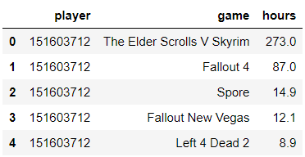
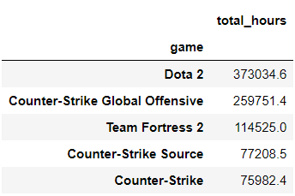
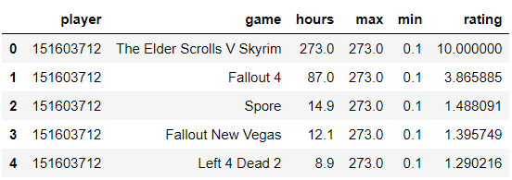
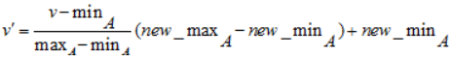

CLEANING AND SCALING
Similar cleaning for both models
Removed ‘behavior’ and ‘other’ columns, purchase rows, and accounts with < 5 games
Left with 2,436 players and 3,544 games
Mean hours was 40.58
Min-max normalization formula for scaling [5]
Problem? 1 game with high hours
Notes:
Mike
When it came to our needs, it was clear that the data held some unnecessary information. This is evident from Table I. Columns labeled as ‘behavior’ and ‘other’ were not required. Similarly, the rows with a ‘behavior’ of purchase and ‘quantity’ of 1 did not say anything useful. As a result, they were removed. We also deemed it important to remove gamers with a game count that was less than 5. This was so that we would only run our recommendation algorithms on more active accounts.
In order to scale the hours so that they took the form of a game rating given by the player, we made use of the min-max normalization formula shown in Eqn. 1. As indicated by this formula, we created a 1-10 rating by taking each game a user had played, subtracting the minimum number of hours they played from the total hours the game under question was played, divided that by the difference between the maximum amount of hours they gamed and the minimum, multiplied the result by the difference between the desired maximum and minimum, and, finally, added the desired minimum. This meant that the game played the most would be given a score of 10, while the game played the least would be given a rank of 1. Everything in between would be scaled between those values.
The cleaned data consisted of only a ‘player’, ‘game’, and ‘hours’ column. It can be viewed in Table II. With the removal of the ‘behavior’ and ‘other’ columns, as well as the rows with a ‘behavior’ of purchase and ‘quantity’ of 1, we had a more straightforward data set to work with. It was also the case that the total number of players and games went down from 11,350 to 2,436 and 3,600 to 3,544, respectively, after accounts with less than 5 games in their play library were removed.
This simplified set created opportunities to better explore it in a variety of ways. For example, we found that Dota 2 was the most played game with a ‘total_hours’ of 373,034.6. The rest of the top 5 most played games are displayed in Table III. It was also revealed that the mean hours games are generally played is roughly 40.58.
Determining the maximum and minimum for each player, along with his or her min-max normalized ratings for each played game, resulted in a data set of the form found in Table IV. This table shows that The Elder Scrolls V Skyrim was player 151603712’s most played game. It’s hours are therefore the value of the maximum and that game has been given a rating of 10 out of 10.
One interesting piece of information that was found after cleaning the data set and checking the total number of hours each game has been played was that the top 5 most played games are all games made by the Valve Corporation. These are located in Table III. This brings to question whether Valve may recommend their own games more than others within their Steam marketplace.
Another thing to note when it came to the results of cleaning and scaling the data was the problem that occurs when a player has sunk a very large amount of time into 1 game and only a small, but more reasonable, amount of time in others. Table IV shows that the player under question played The Elder Scrolls V Skyrim for 273 hours, while the rest of his or her games have not even broken the 100-hour mark. Some games can simply be beaten in a small chunk of time. Is the fact that they weren’t played as much as a sandbox game designed for exploration mean they deserve such a low score? It may be the case that a better way of calculating a rating ought to be configured.

Slide 6
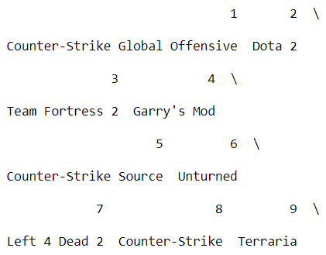
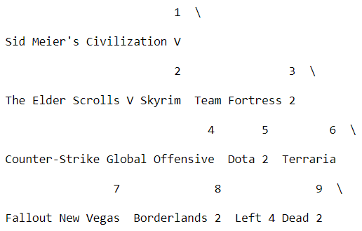

RECOMMENDATIONS BY GAME WITH SCALED DATA
Step 1: Players-by-games data frame created with ratings
Step 2: Games-by-games frame made by taking transpose and dot product
Step 3: Recommendation data frame
Expectation? Inputted game’s genre matches suggested
Result? True for CSGO, but not for Civilization
Why? Story, art styles, and leveling systems?
Notes:
Mike
Implementing the algorithm for a recommendation system that takes a game as an input and offers similar games first demanded the creation of a players-by-games data frame. The values used to create this were the ratings. Basically, every player took on a row and every game had its own column. For those games not played by a user, a 0 rating was entered. Otherwise, their score of a game calculated from the hours they spent playing it made up the cell.
This was then followed by a games-by-games data frame being declared and filled by taking the transpose and dot product of the players-by-games frame. Lastly, the final step was to fill in a new recommendation data frame by looping once through the columns of the games-by-games frame and sorting the scores found from the transpose and dot product calculation. It was expected that the end result would be a system in which games of a similar genre to the inputted game would be recommended.
The recommendation system that would recommend video games based on the game passed in successfully listed out the desired number of software titles. Fig. 1 shows the output after inputting the first-person shooter Counter-Strike Global Offensive. As it can be seen, players who like that game should also try out games like Dota 2, Team Fortress 2, and Garry’s Mod.
Similarly, Fig. 2 shows the results given when the system is fed the Sid Meier’s Civilization V title. The Civilization games are more strategy-oriented. Gamers who enjoy that type of game may also find The Elder Scrolls V Skyrim, Team Fortress 2, and Counter-Strike Global Offensive worth investing some time in.
The item-based system, which was passed a game, could produce some meaningful results. More specifically, if a first-person shooter was given, the system would tend to output other first-person shooter games. As shown in Fig. 1, inputting Counter-Strike Global Offensive outputted other shooters like Team Fortress 2, Garry’s Mod, Counter-Strike Source, Unturned, Left 4 Dead 2, and Counter-Strike.
On the other hand, it could also give some questionable results. For example, passing in Sid Meier’s Civilization V, which is a strategy game, did not cause the recommender to produce any other obviously related strategy games. This is clear from the results displayed in Fig. 2. Reflecting on these contradictory types of output, it seems obvious that defining game similarity by whether or not 2 games fall into the same genre is a naive outlook. Video games ought to be compared in a multitude of ways such as story, art styles, and leveling systems.

Slide 7
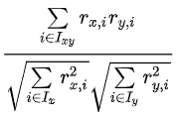
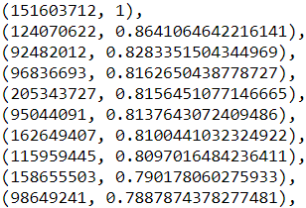
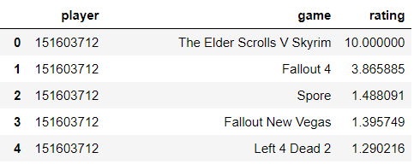
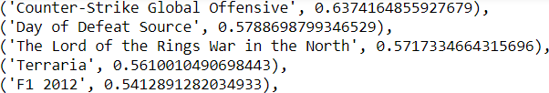

MODEL 1: RECOMMENDATIONS BY PLAYER WITH SCALED DATA
Step 1: Find players most like inputted gamer with cosine similarity formula [11]
Step 2: Fill players-by-games frame with weighted averages
Step 3: Recommendation list
Hypothesis? Owned highest rated games have same genre as highest recommended
Result? Player 151603712 brought high cosines, low ratings, but 2/5 FPS and 1/5 fantasy RPG recommendations
He or she was a 3/5 FPS and 1/5 fantasy RPG player
Why? ∞ games and most-played game throws off the ratings? Need different way to measure game similarity?
Notes:
Mike
Finding games for an inputted user would be a bit more involved. For model 1, it began with the determination of those players who were the most similar to the gamer passed in. The main formula utilized for this purpose was Eqn. 2. Here, the cosine similarity calls for getting the passed in player’s game ratings, finding the sum of products between them and each of the other player’s scores, and then dividing each of those results by the relevant product of their squares, sums, and roots.
Once that was completed, a players-by-games data frame of the most similar gamers was created with the added column of their cosine similarities placed at the end. Weighted averages filled the empty cells in the passed-in player’s row so that the highest averages, or ratings, could be recommended. These game averages were calculated by taking each other player’s rating for that game, multiplying it by their similarity score, adding the result to a running tally for the game, and then dividing it by the sum of the cosines for all players.
The final step was to create a recommendation list for the passed-in player and fill it with the unplayed games holding a weighted rating. This could be done by iterating over his or her game row and checking for values over 0. After doing this and gathering the games, they were sorted from greatest to least making the beginning hold the games that the recommendation system assumes the player would rank the highest if he or she was to play them. The hypothesis was that a player’s already-owned greatest ranked games would be of the same genre of the highest rated recommended games.
When it came to the model 1 results for player 151603712, the most similar gamers all had fairly close cosine similarities. This was typical for any user passed in. A total of 9, excluding the passed in player, are displayed in Fig. 3. The values shown range roughly from 0.86 to 0.79.
Some games already owned by player 151603712 can be viewed in Table V. The Elder Scrolls V Skyrim holds a rating of 10, while Fallout 4 approaches a score of 4. The rest of his or her games do not exceed 1.5.
Fig. 4 are the top games the model 1 recommendation system would suggest to this player. They include Counter-Strike Global Offensive, Day of Defeat Source, The Lord of the Rings War in the North, Terraria, and F1 2012. The second number in each tuple is the weighted average, or rating, expected by the player.
The first model for recommending games to a specific player outputted some high correlations when it came to the finding of similar gamers. Each of the users in Fig. 3 were above 0.75. This was a good sign and pretty common when different players were fed into the recommendation system.
One problem with model 1 was the very low calculated ratings. It seems possible that there are just too many games and the ratings need further tuning. As stated before, a player’s most-played game can throw off the rest of his or her formula-deriven ratings for lesser-played games.
Despite the shortcomings of these low ratings, some of the games suggested in Fig. 4 do make quite a bit of sense. Fallout 4, Fallout New Vegas, and Left 4 Dead 2, which player 151603712 already owned, are all first-person shooter games, while The Elder Scrolls V Skyrim is a fantasy role-playing game. The recommended games list holds Counter-Strike Global Offensive, Day of Defeat Source, and The Lord of the Rings War in the North at the top with the highest calculated ratings. This is 2 first-person shooter games and 1 fantasy role-playing game. In other words, the recommendations do have similarities with the user’s already-owned games. However, it needs to be remembered that game similarity ought to be measured by more than just genre.

Slide 8
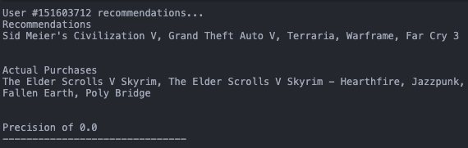

MODEL 2: RECOMMENDATIONS BY PLAYER WITH ORIGINAL HOURS DATA
Step 1: Clean data, remove "purchased" to keep only "play" hours, keep > 10 games
Step 2: Generate User & Game matrix
Step 3: Get recommendations
Methodology: Collaborative Filtering
Result: For user 151603712, we get a precision of 0.0
What this shows: With no extra modification to the hours, the precision will be low.
≅
X
R
U
V
Notes:
NATE:
Our 2nd Model (which was developed for the first checkpoint), introduced the idea of collaborative filtering
Collaborative filtering is a type of recommendation system that infers the user's preferences for a new item, based on the preferences of other users
U = Users
V = Games
R = Final results
We first filter the data by removing all instances of purchased from the purchased in "purchased/play" and 1.0 for "hours"
Remove all users who have played less than 10 games
Then we map indices for the user and game matrix's, to begin making correlations between users' hours across games, and their purchases
Iterate through the data making correlations
Print recommendation results

Slide 9
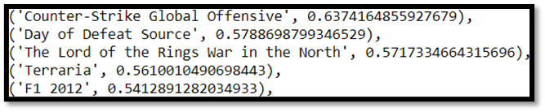

COMPARISON OF MODELS
Model 1 has a much higher effectiveness, making correct recommendations more often
Model 2 often yields a 0.0 precision, but does have some occasional 0.2-0.4 precisions
Model 2 helped set the ideas for Model 1
Notes:
NATE:
Model 1 had a much higher effectiveness, recommending games with a higher precision due to the scaling of hours into a rating system
Model 2 set a decent foundation for going about building this rating system
Model 2 often would not recommend any games correctly to a user's purchases
Here is a comparison of the results generated from both algorithm

Slide 10
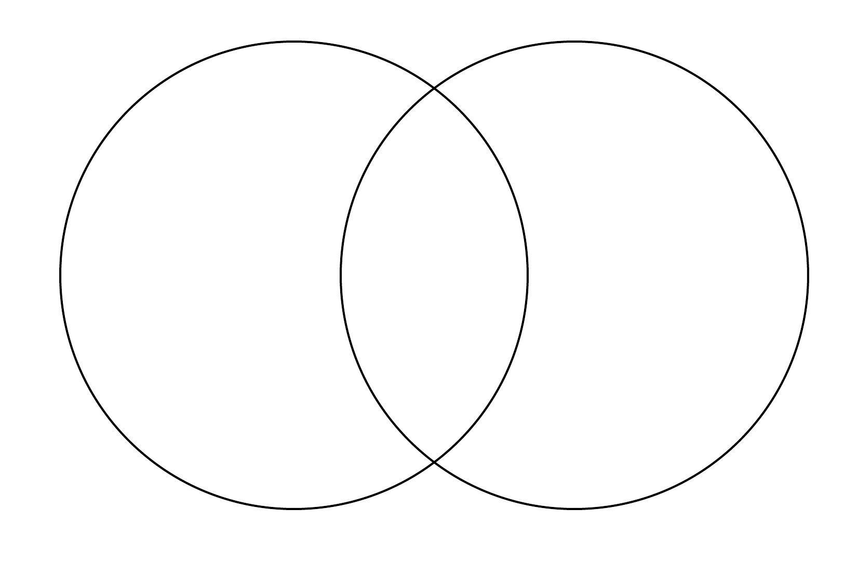

CONCLUSION
Recommendation by game results did not match hypothesis completely
Model 1 results did math our expectations, but had low calculated ratings
Model 2 results has low precision, but was a good foundation
Which model performed better?
Genre is only one means of measuring game similarity
Story, art styles, leveling systems, etc.
Need better way of scaling
More user behaviors to create more comprehensive consumer sentiment
Notes:
NATE:
For the recommendation by game results, inputting CSGO brought about 6/8 FPS titles, while Civilization output 0/8 strategy-oriented games.
Model 1 seemed to work for the inputted FPS and fantasy RPG player, but ratings were low
Model 2 set a good foundation for Model 1, allowing us to see a recommendation (while not always accurate), and lead to a solid idea for the Model 1 system
The main problem with our work seems to be our difficulty in measuring the difference between good and bad recommendations.
We can go with genre, but this seems too naïve. Maybe we should take in other aspects of games such as their stories, art styles, and leveling systems.
We also need a better way of scaling the data. One highly played game can complete throw our ratings off.
More user behaviors would also be helpful in better developing player sentiment, or preference.

Slide 11
REFERENCES PART 1
[1] A. Biswas, K. S. Vineeth, A. Jain and Mohana, “Development of Product Recommendation Engine By Collaborative Filtering and Association Rule Mining Using Machine Learning Algorithms”, 2020 Fourth International Conference on Inventive Systems and Control (ICISC), Coimbatore, India, January 2020, pp. 272-277, doi: 10.1109/ICISC47916.2020.9171210.
[2] S. J. Russell and P. Norvig, Artificial Intelligence: A Modern Approach, 3rd ed. Upper Saddle River, NJ, USA: Prentice Hall, 2010.
[3] M. H. Mohamed, M. H. Khafagy, and M. H. Ibrahim, “Recommender Systems Challenges and Solutions Survey”, 2019 International Conference on Innovative Trends in Computer Engineering (ITCE), Innovative Trends in Computer Engineering (ITCE), 2019 International Conference, Aswan, Egypt, February 2019, pp. 149–155, doi: 10.1109/ITCE.2019.8646645.
[4] D. J. Dudhia, S. R. Dave, and S. Yagnik, “Self Attentive Product Recommender – A Hybrid Approach with Machine Learning and Neural Network”, 2020 International Conference for Emerging Technology (INCET) Emerging Technology (INCET), 2020 International Conference, Belgaum, India, June 2020, pp. 1–4, doi: 10.1109/INCET49848.2020.9154034.
[5] F. R. Rehman. “Min Max Normalization in data mining.” T4Tutorials. https://t4tutorials.com/min-max-normalization-of-data-in-data-mining/ (accessed December 15, 2020).
Notes:
Nathan
Part 1 of our references…

Slide 12
REFERENCES PART 2
[6] S. Marafi. “Collaborative Filtering with Python.” Salem Marafi. http://www.salemmarafi.com/code/collaborative-filtering-with-python/#:~:text=Collaborative%20Filtering%20with%20Python%201%20Refresher%3A%20The%20Last.FM,collaborative%20Filtering.%20...%204%20Entire%20Code%205%20Referenence (accessed December 15, 2020).
[7] Santhosh. “Recommendation Systems: Collaborative Filtering just with numpy and pandas, A-Z.” Medium. https://medium.com/@sam.mail2me/recommendation-systems-collaborative-filtering-just-with-numpy-and-pandas-a-z-fa9868a95da2 (accessed December 15, 2020).
[8] Kaggle User, “steam_game_recommender.” Kaggle. https://www.kaggle.com/jwyang91/steam-game-recommender (accessed December 15, 2020).
[9] Tamber, “Steam Video Games Version 3.” (2016). Distributed by Steam. https://www.kaggle.com/tamber/steam-video-games (accessed December 15, 2020).
[10] PACKT Publishing, Birmingham, England. Building recommendation systems with Python (2019). Accessed: December 15, 2020. [Online] Available: http://search.ebscohost.com.umasslowell.idm.oclc.org/login.aspx?direct=true&db=edsasp&AN= edsasp.ASP4740624.marc&site=eds-live
[11] Wikipedia. “Collaborative filtering.” Wikipedia. https://en.wikipedia.org/wiki/Collaborative_filtering (accessed December 15, 2020)
Notes:
Nathan
Part 2 of our references…

